Slide 1

Restaurant Inspection
Ironhack - Mid Project 13.04.2024
Shakti Pandit

Slide 2

Provides information about hygiene standards of restaurants, which is important for Public awareness

Slide 3
Plan of Action
Understand the Dataset: Examine its structure and meaning of features.
Explore Data: Analyze distributions, relationships, and patterns.
Identify Target Variable: Determine what I want to predict or analyze.
Build Use Case: Formulate a clear objective for analysis.
Clean Data: Address missing values, outliers, and encode categorical variables.
Statistical Studies: Conduct analyses to understand data characteristics.
Visualize Data: Create interactive visualizations with Plotly and Tableau.
Select ML Model: Choose appropriate algorithms for the use case.
Choose Metrics: Select evaluation metrics based on the problem.
Train and Evaluate Model: Split data, train models, and evaluate their performance.

Slide 4
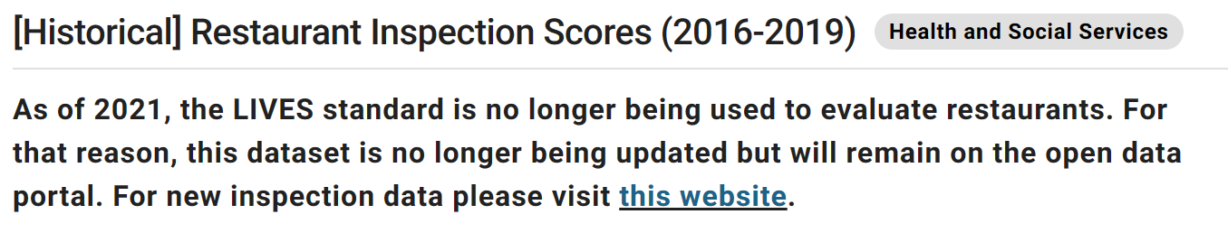
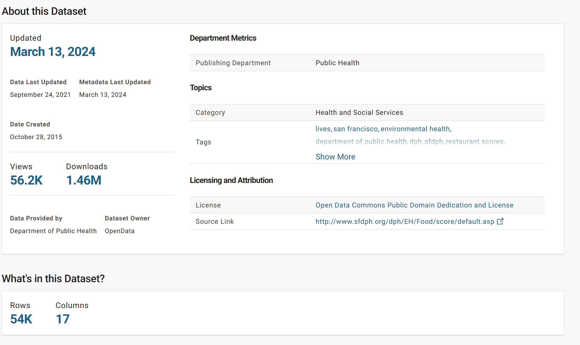
Understanding the Dataset
"After examining all the features, I've concluded that the dataset primarily consists of categorical data and features."

Slide 5

Cleaning Data:
Drop the NaNs: Remove rows with missing values.
Drop columns with more than 50% missing data.
Rename columns if they are not written properly.
Categorize the data into two parts: Inspection and Business.
Business Part wil not so use only for location and address of the business.
For Inspection data, drop unnecessary features.
As the data is categorical, there's no need to isolate numerical and categorical features.
Assign meaningful names to the features

Slide 6

Exploring the Data and Identifying Target Variable
From the given data, I aim to select only necessary columns and add more feature-enriched columns.
The primary focus is on inspection scores, which we want to analyze by grouping them first.
We'll then examine the types of inspections they underwent, which are already categorized as scheduled or unscheduled.
Additionally, the data identifies risk categories as low risk, moderate risk, and high risk.
We'll also consider the violation description and inspection year.
From this information, I aim to identify additional features for the data to accurately target inspection scores and understand the criteria on which they are assessed.

Slide 7
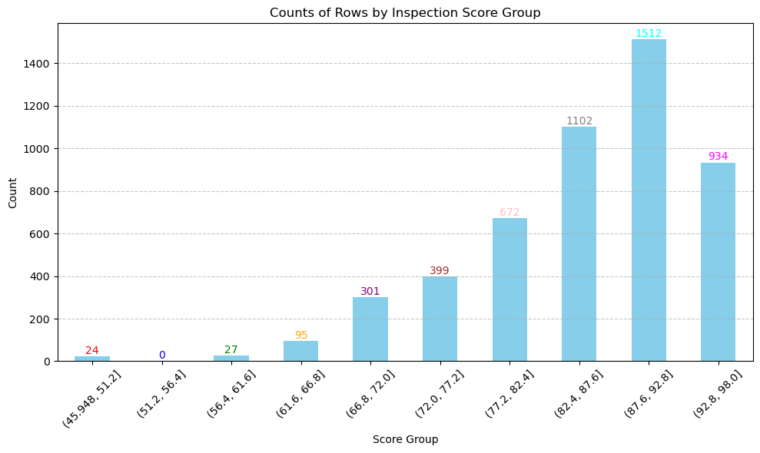

Slide 8
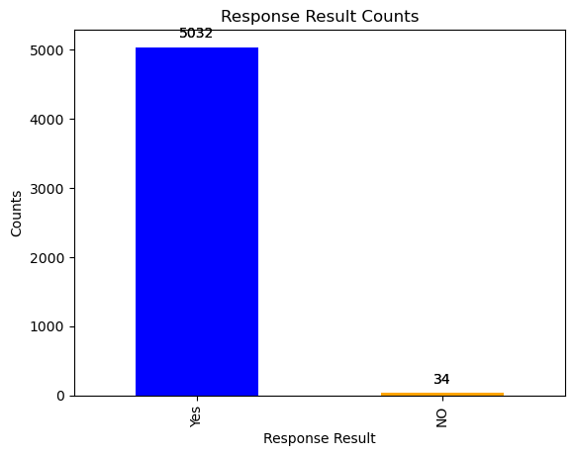
Initially, first I separated the inspection score into two Categories in new column inspection_result: Wether they pass the Inspection or not.

Slide 9

For the risk category effect on public health, I am initiating two columns: one for risk category and another for ratings based on the risk.
High Risk with a risk of foodborne illness, they will be assigned a rating of 0 stars.
Moderate Risk with a risk of Dizziness will receive ratings of 3 .5 stars.
Lastly, Low Risk with no immediate risk to public health will be given as 5-star rating."

Slide 10
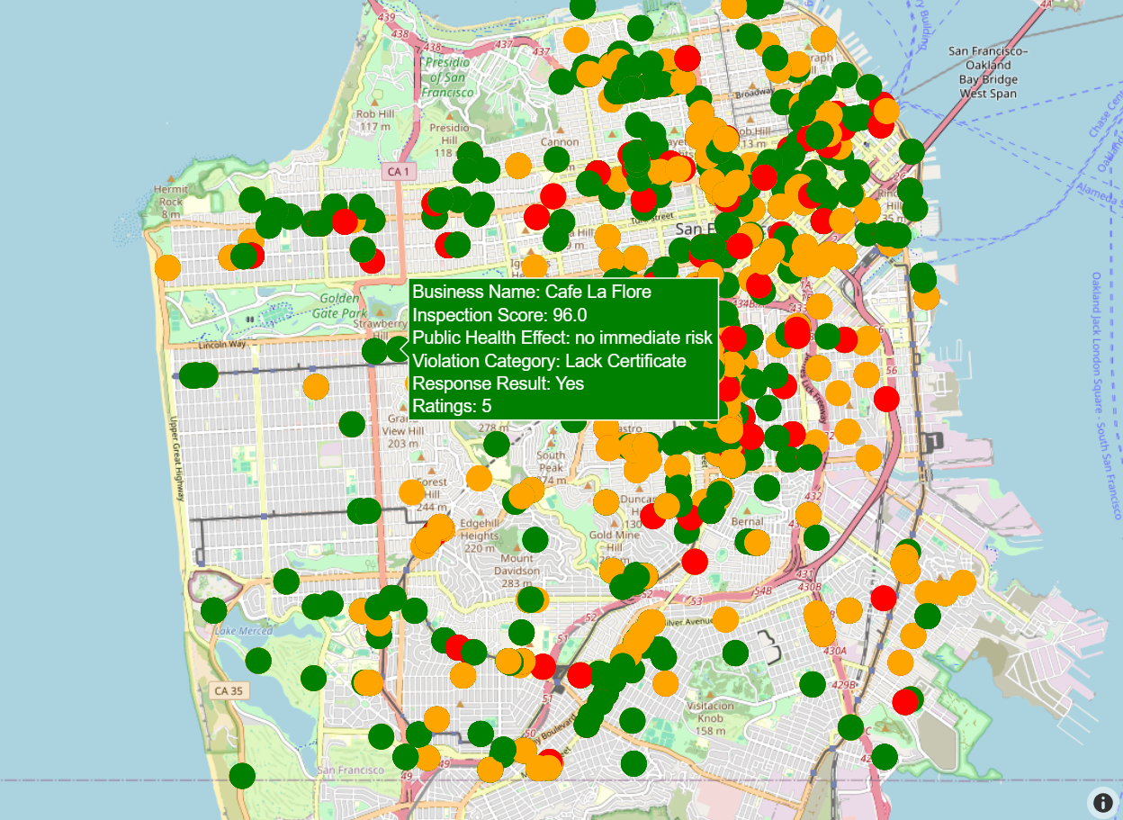
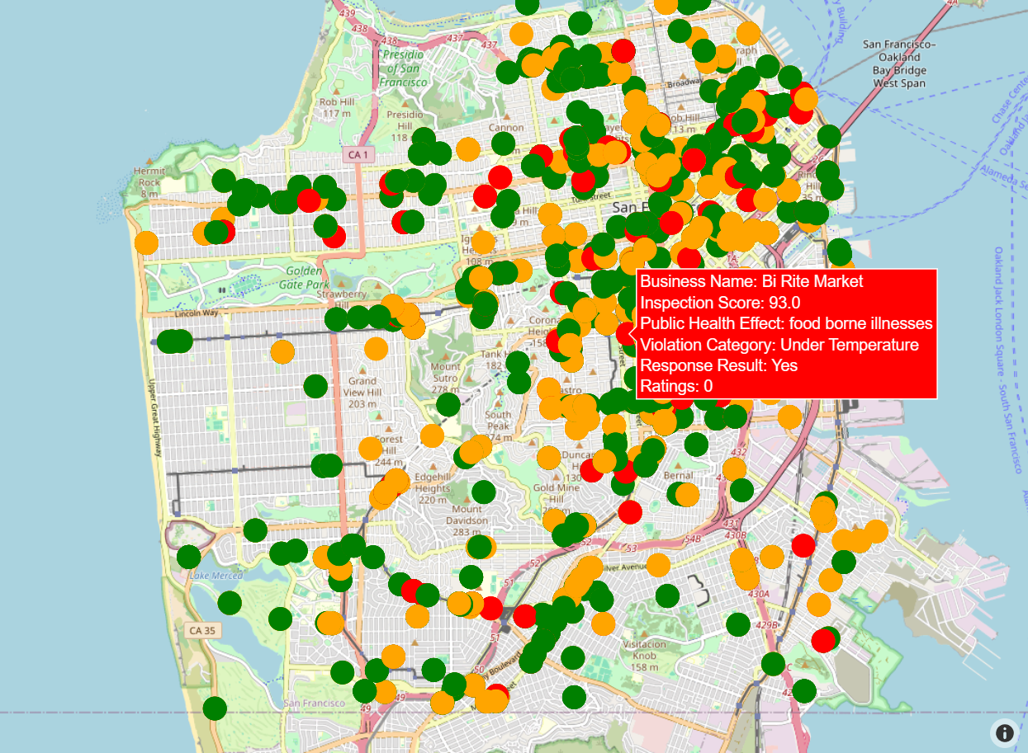
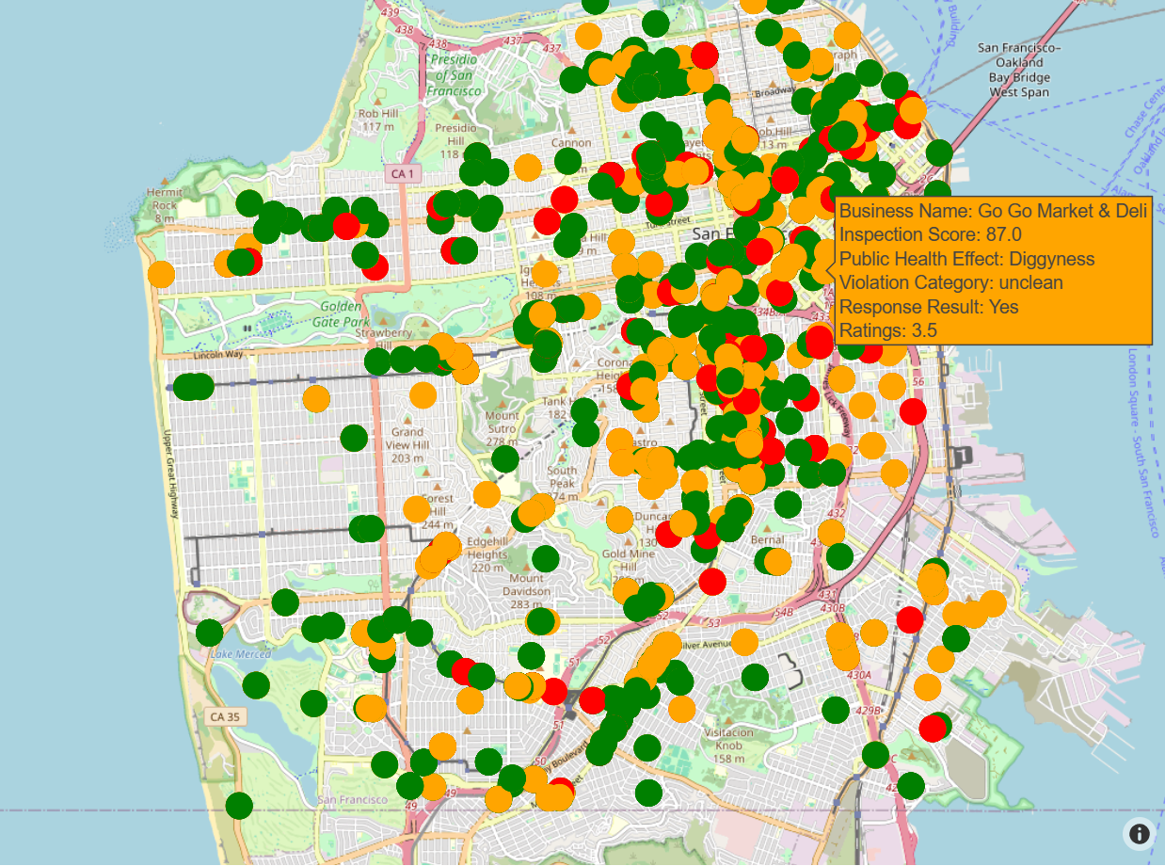

Slide 11
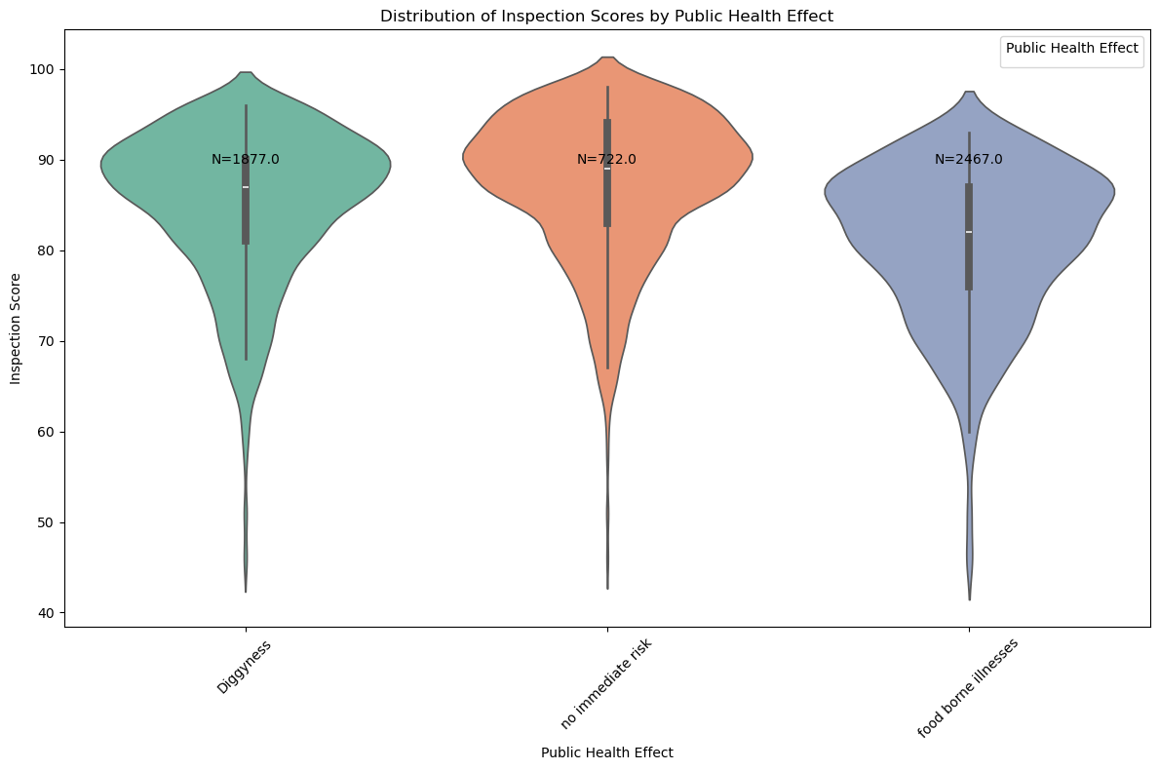
Almost half of the restaurants are in the high-risk category, which poses a significant public health concern as it may lead to a higher incidence of foodborne illnesses among guests.
Meanwhile, the other half of the restaurants are considered acceptable.
Only 25% of restaurants are categorized as having no risk.
Suggestion: Finding a restaurant with no risk is not always easy. It's essential to carefully consider all factors before deciding on a restaurant, including its inspection score and ratings, to ensure a safe dining experience.

Slide 12
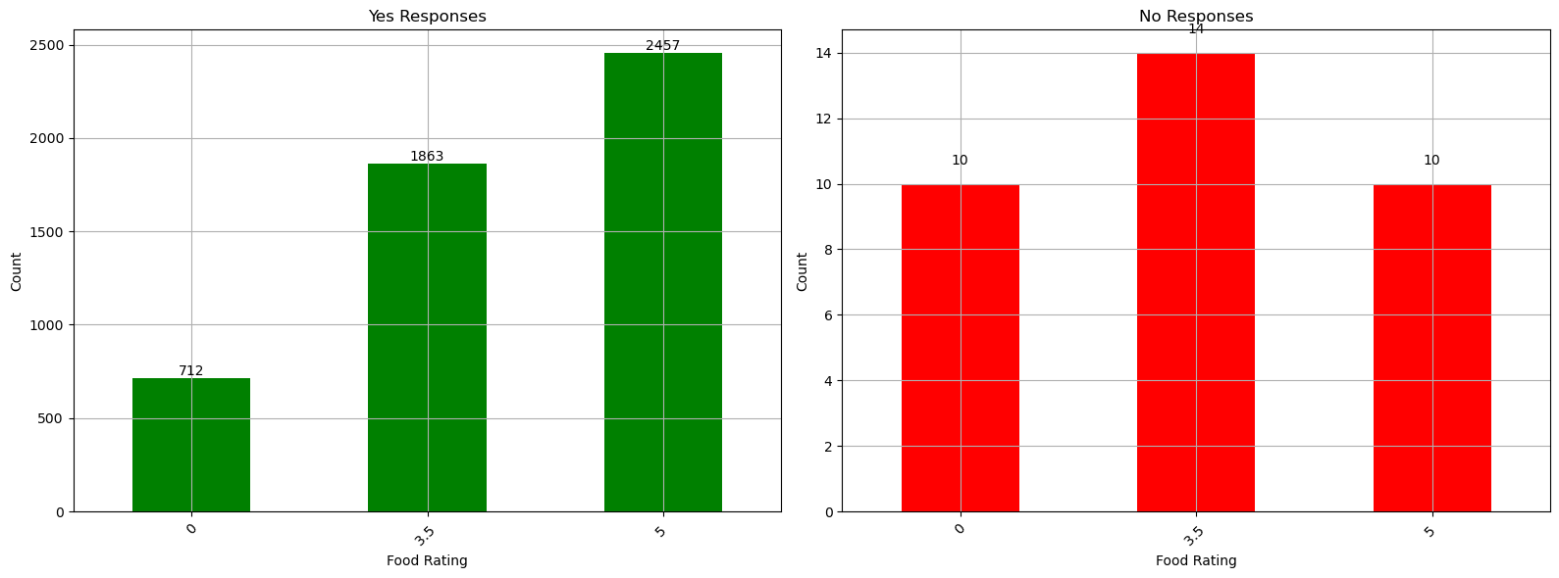
During the inspection, it was found that 34 restaurants did not pass. Surprisingly, among these failing restaurants, some had ratings of 3.5 and even 5. Additionally, nearly 60% of these failing restaurants were not categorized as high-risk.
On the other hand, 712 restaurants passed the inspection but were still considered high risk.
Why did this happen? Can anyone give a hint?

Slide 13
Don't forget, during each restaurant inspection, the main factor affecting the score is violations. We also have violation descriptions, which significantly impact the inspection score and ratings.
In this dataset, there are more than 100 violation descriptions. I've categorized them into 9 categories, which make it much easier to understand the nature of the violations.
Unclean
Lack of equipment
Under Temperature
Contaminated
Unmanage
Lack Certificate
Under maintenance
Untrained worker
Not convinced

Slide 14
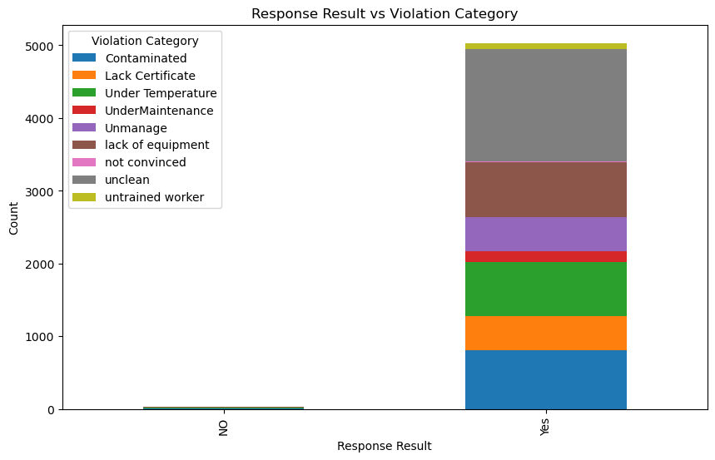
The prevalence of violations among passing inspections suggests a need for stringent criteria and significant point deductions to fail inspections, emphasizing the importance of reevaluating inspection protocols to ensure food safety standards are upheld effectively.

Slide 15
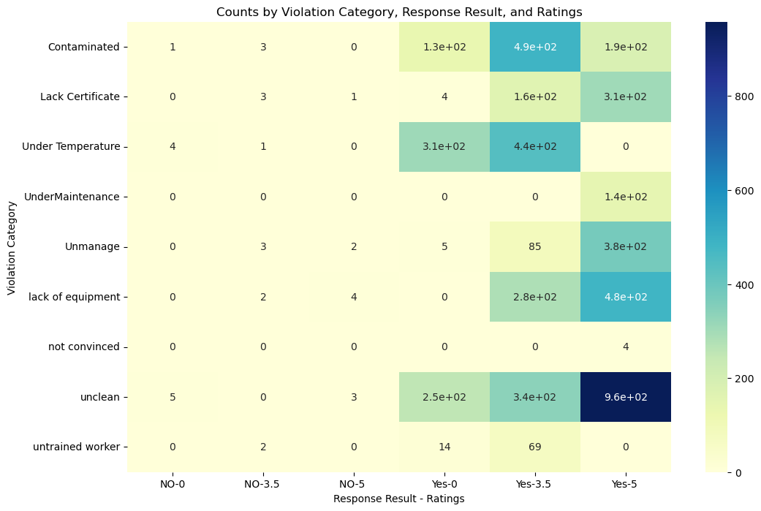

Slide 16
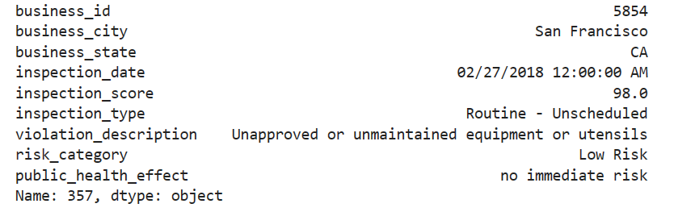
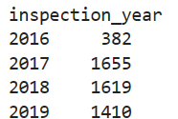
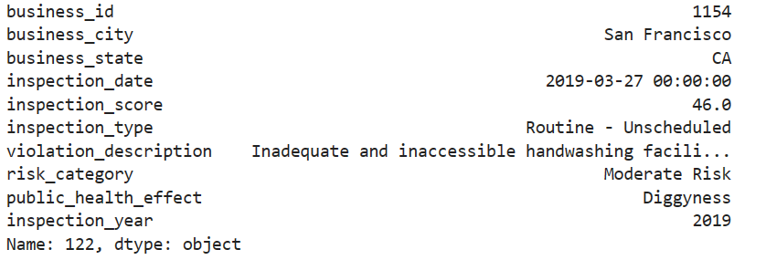
Maximum Score
Num of Inspection Per Year
Min Score

Slide 17
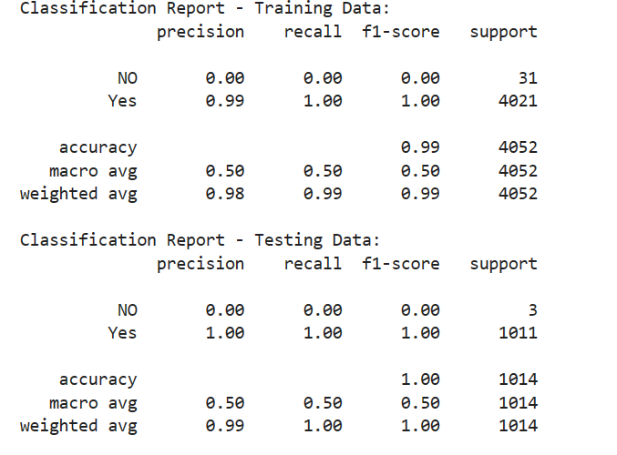
After Presentation
I change it after Presentation
After analyzing the results, it's evident that the inspection score depends significantly on the features of the data. To gain clarity on this matter, let's delve into machine learning with the following
features = ['business_city', 'business_state', 'inspection_type', 'risk_category', 'public_health_effect', 'ratings', 'violation_Category’]
target = 'responce_result'
Based on the dataset characteristics, the decision all feature I decided to decision tree and Logistic regression due to the categorical nature of the dataset.
Upon predicting the inspection score using these features, the results are as follows:
Training Accuracy: 0.9923494570582428
Testing Accuracy: 0.9970414201183432
Training Data Performance:
The model is excellent at predicting instances labeled "Yes."
But it fails to predict instances labeled "NO," getting them all wrong.
Testing Data Performance:
Again, the model is perfect at predicting "Yes."
But it still can't predict "NO" correctly, getting them all wrong.#
What It Means:
The model is great at predicting the majority class ("Yes") but struggles with the minority class ("NO").
It's like being really good at answering one type of question but bad at another type, even when you've seen examples of both types.
To improve, the model might need more examples of the minority class or adjustments to its training.
So doing all these, we can conclude that almost all Businesses pass the inspection

Slide 18
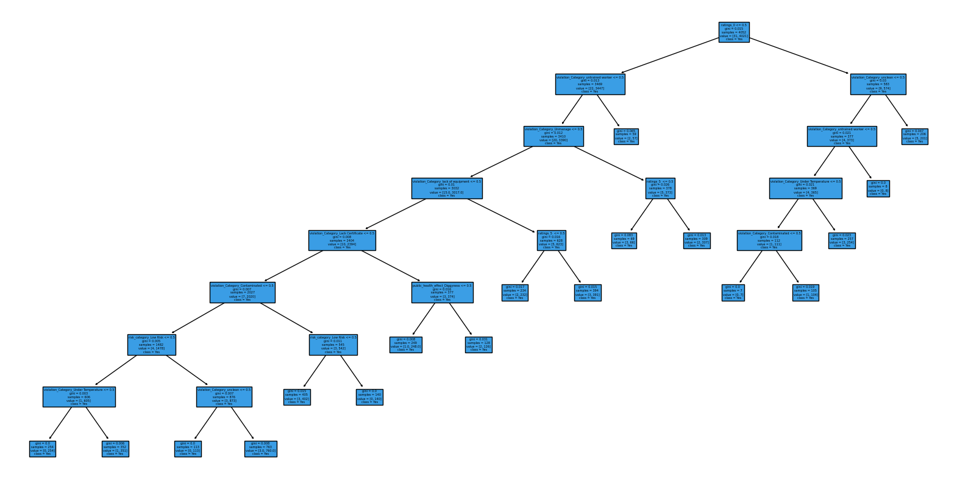
[:

Slide 19
What I can do more :
Feature Engineering:
Explore additional features or transformations of existing features that might better capture the relationship with the target variable.
Consider interactions between features or polynomial features.
Model Complexity:
Experiment with different hyperparameters for the decision tree (e.g., max depth, minimum samples per leaf, etc.).
Prune the tree to prevent overfitting.
Evaluate Other Models:
Decision trees might not be the best choice for your specific problem. Trying other regression models random forests, or gradient boosting may also givea nice result
Cross-Validation:
Use cross-validation to assess the model's performance on different subsets of the data.
model performance often involves an iterative process of experimentation and evaluation.

Slide 20
Working Alone: I've gained experience in working independently, which I believe is essential for my personal growth and development.
Importance of Mentorship: I've come to recognize the value of having a mentor to guide me through challenges and provide valuable insights.
Understanding Data: I've learned about different types of data (classification or regression) and how to analyze them effectively.
Problem-solving Skills: I've been honing my ability to tackle problems efficiently and find solutions through critical thinking and creativity.
Coding vs. Note-taking: I've understood the balance between coding and documenting my work for better organization and future reference.
Applications of Machine Learning: I've been exploring the practical applications of machine learning and its usefulness in various domains.
Feature Selection: I've been identifying which features are relevant for building machine learning models and extracting insights from data.
Work Progress and Reporting: I've been focusing on communicating my work progress and findings effectively to stakeholders.
Feedback Importance: I've acknowledged the significance of receiving feedback for my continuous improvement.
Deep Learning Exploration: I've been delving into deep learning techniques and understanding their role in solving complex problems.
Challenges in Data Analysis: I've recognized the challenges involved in data analysis, such as dealing with missing values (NaN) and selecting appropriate datasets.
Choosing Datasets: I've learned how to choose datasets that are suitable for specific analysis tasks.
I'm committed to keeping up the great work and continuing to apply what I've learned to further my skills in data analysis and machine learning!
Learning in Two Weeks

Slide 21

Question and Answer!

Slide 22


